Slide 1
Convolutional Operation
Chen-Kang (Angus) Tsai
Email: angus@cereal.cse.nsysu.edu.tw
Date: 2020/12/2

Slide 2
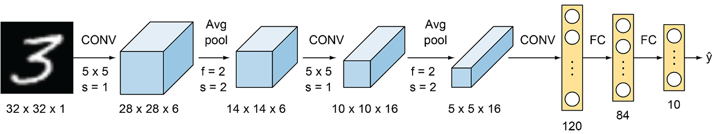
Convolution Operation
Convolutional neural network (CNN) often used for image recognition
When an image is input to CNN, the output result will be the recognition result of this image

Slide 3
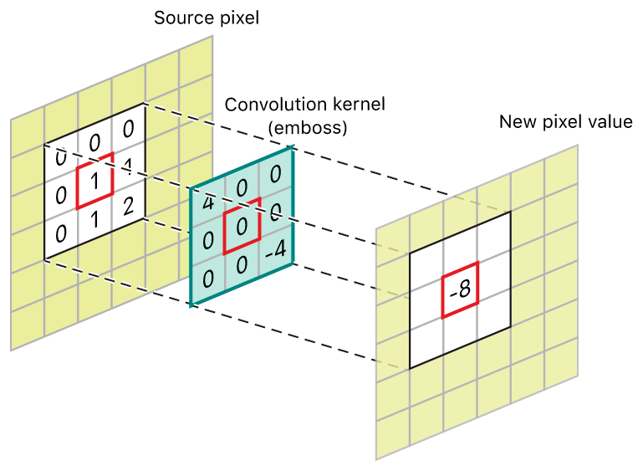
Convolution Operation
Convolutional operation is to multiply input data with kernel
The kernel is the weight of convolution layer

Slide 4
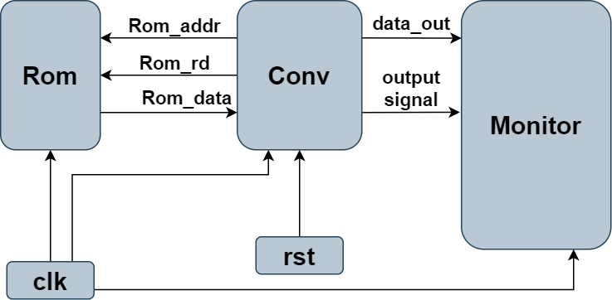
Lab3
Design a convolution operation unit
System block
clk
reset
Rom
Conv
Monitor

Slide 5
Lab3
Rom is used to store input data (index:0~8) and weight (index:9~18)
There are some signals to control the rom block
rom_rd
rom_addr
Index
data
0
input1
1
input2
2
input3
16
weight8
17
weight9
18
bias
Rom

Slide 6
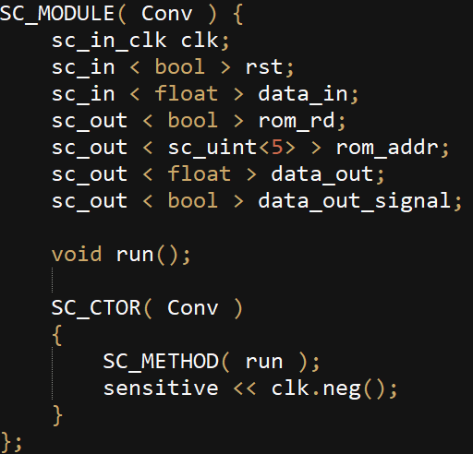
Lab3
Conv
You need to read the rom data cycle by cycle
Reading data from ROM will delay one cycle
Conv.h

Slide 7

Lab3
Execution result

Slide 8
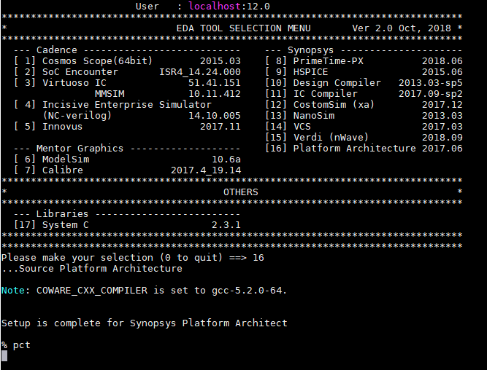
Platform Architect
%tool -> 16 -> enter -> 0 ->enter

Slide 9
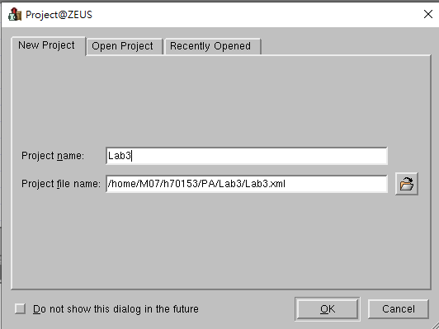
Platform Architect
Create project -> Project name -> Project file name -> OK

Slide 10
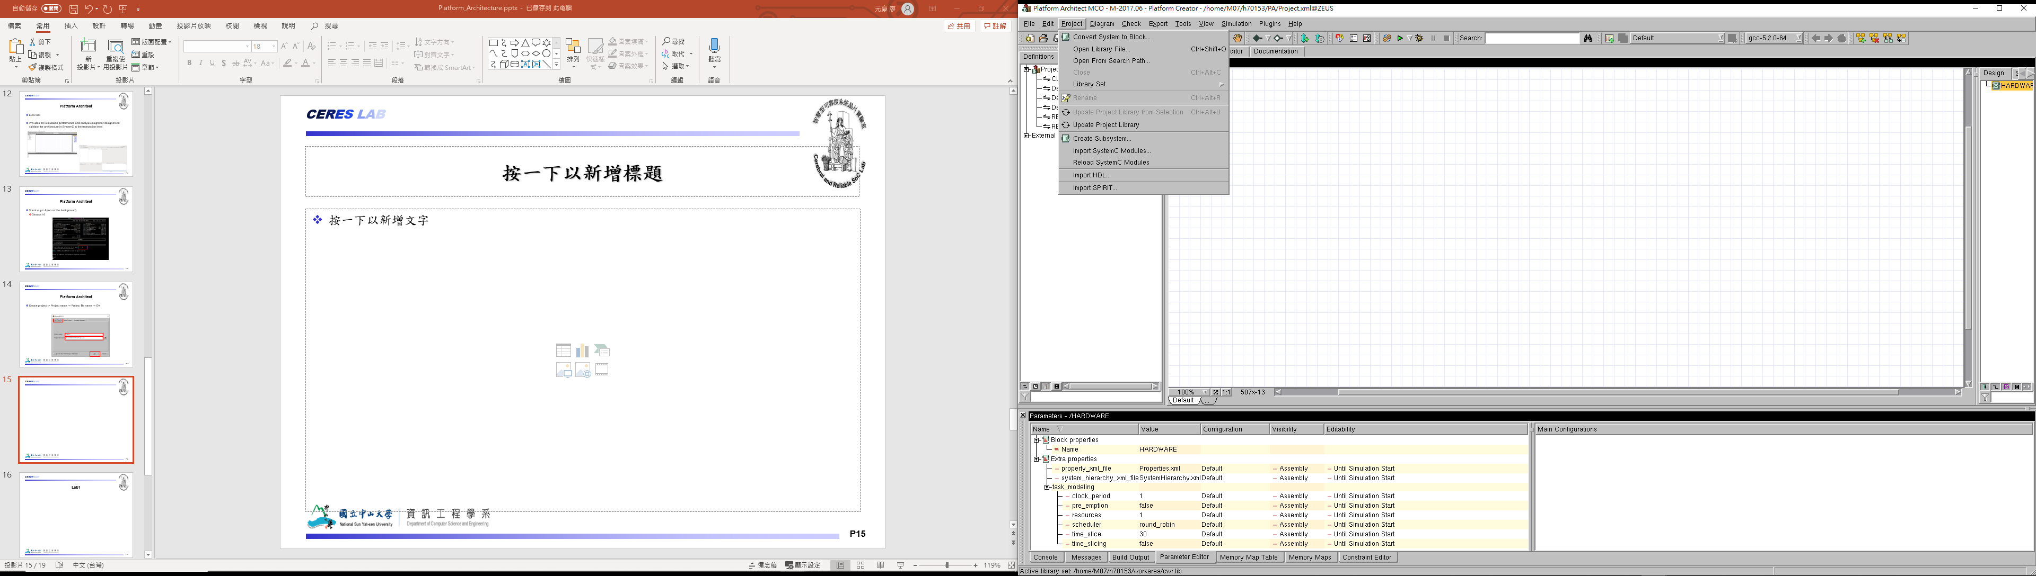
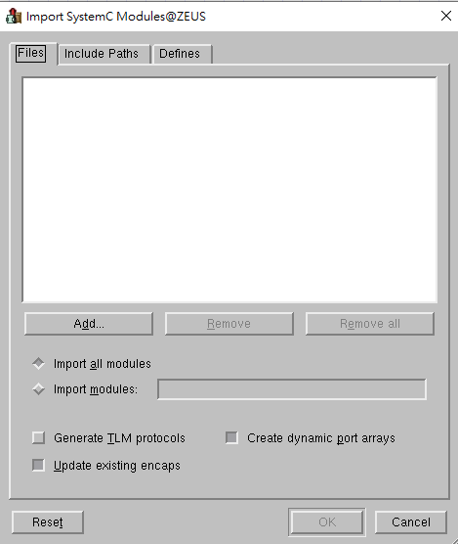
Platform Architect
Import SystemC Modules -> Add -> Choose all the source file

Slide 11
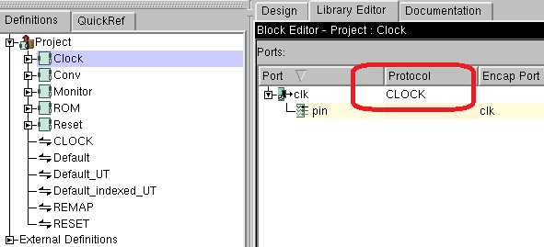
Platform Architect
Set the clk port of Conv, Clock, ROM and Monitor block to CLOCK protocol

Slide 12
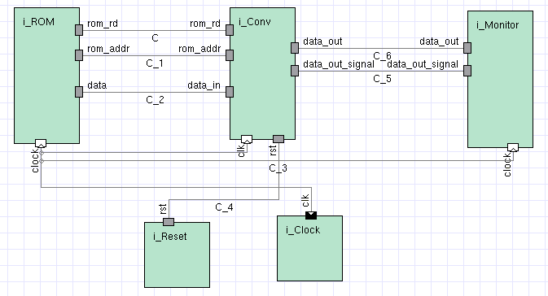
Platform Architect
Create the block diagram

Slide 13
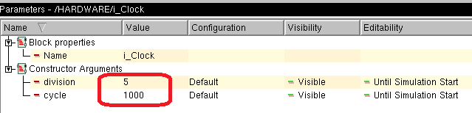
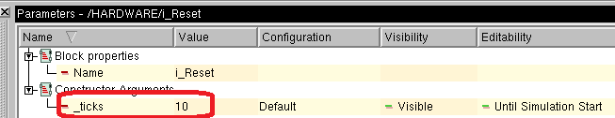
Platform Architect
Click clock block -> Set clock period
division -> 5
cycle -> 1000
Click Reset block -> Set reset period
_ticks -> 10

Slide 14

Platform Architect
Simulation result

Slide 15
Requirement
Due in one week (12/9)
Complete Convolutional operation.
Use Platform Architecture to simulate output result.
Source code ( all of your file, include PA project file, source code…. ).

